Slide 1
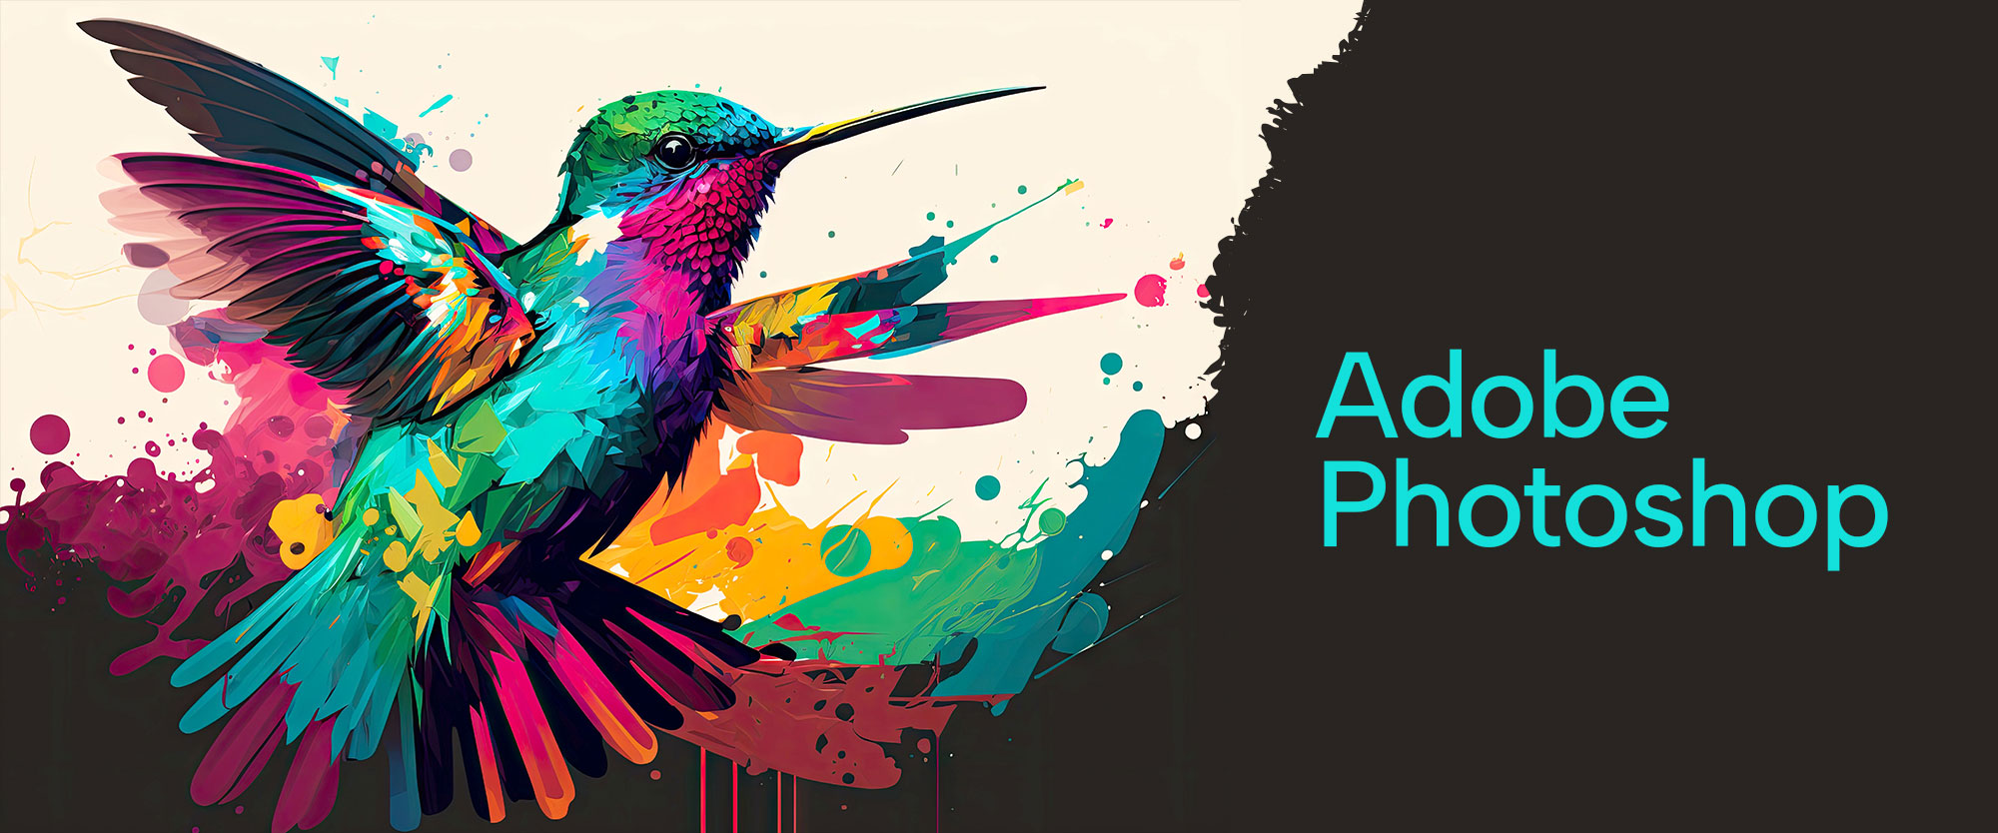

Slide 2
About today…
Basic Image Editing Tools Overview
Workspace Customization

Slide 3
Intro to Basic Tools
Frequently used for basic image editing tasks
Mastering these tools is crucial for effective image editing
Move Tool
Brush Tool
Eraser Tool
Text Tool

Slide 4

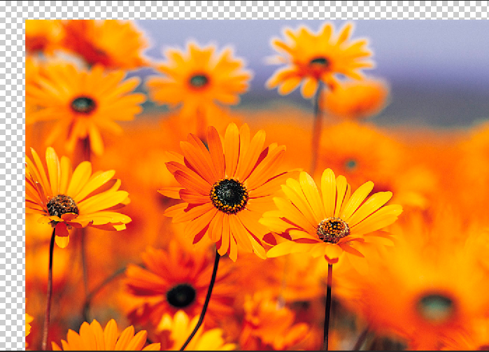
Move Tool
Used to move selected areas, layers, and guides within the canvas

Slide 5


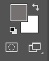
Brush Tool
Used for painting and drawing on the canvas with different brush shapes and sizes

Slide 6

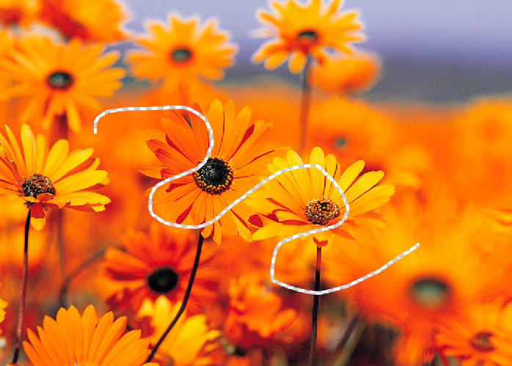
Eraser Tool
Used to remove parts of an image or a layer

Slide 7


Text Tool
Used to add and/or edit text within an image

Slide 8
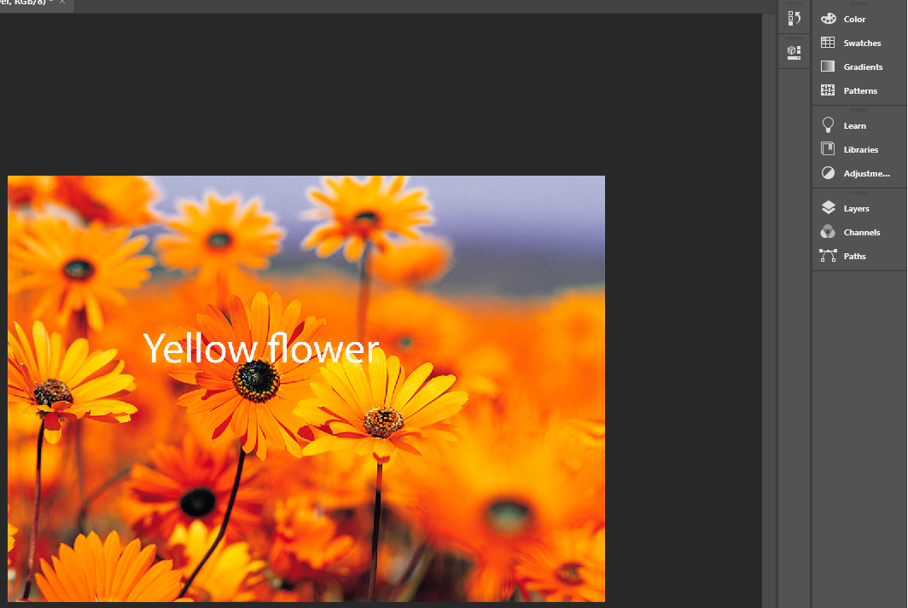
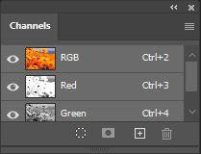
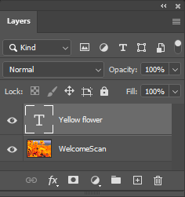
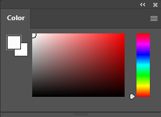
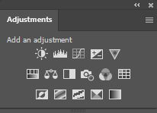
Workspace Customization

